Slide 1
Child Sexual Exploitation (CSE): Briefing for the School Community
Notes:
Facilitator: Please ensure that you are familiar with the content of this PowerPoint and associated Government guidance before delivering the briefing. It is advisable for you to access the additional information on CSE on the LSCB website in advance. Please allow approximately 15 minutes to deliver the briefing and for questions.
http://www.redbridgelscb.org.uk/professionals/child-sexual-exploitation/

Slide 2
What is CSE?
Child Sexual Exploitation (CSE) is a form of child sexual abuse.
It occurs where an individual or group takes advantage of an imbalance of power to coerce, manipulate or deceive a child or young person under the age of 18 into sexual activity (a) in exchange for something the victim needs or wants, and/or (b) for the financial advantage or increased status of the perpetrator or facilitator.
The victim may have been sexually exploited even if the sexual activity appears consensual.
CSE does not always involve physical contact; it can also occur through the use of technology.
(CSE Definition & Guidance – Department for Education, February 2017)
Notes:
This is the Government’s definition of CSE.
For further information see: http://www.redbridgelscb.org.uk/professionals/child-sexual-exploitation/

Slide 3
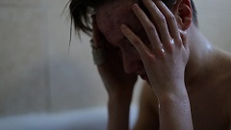
Child Sexual Exploitation (CSE)
What makes some children and young people more vulnerable of this type of abuse than others?
Children with Disabilities/Special Educational Needs
Care leavers/Looked After Children (LAC)
Those experiencing bullying
Children who go missing from home or care
Those misusing alcohol and/or drugs
Homelessness and poverty
Parenting capacity issues, including DV, parental mental health
Those with attachment issues
School non-attendance
Mental health disorders including depression
Those known to existing victims e.g. siblings, friends
Those with a poor understanding of sexual relationships
History of abuse e.g. familial child sexual abuse, risk of forced marriage/honour-based violence
Young offenders
Being a young carer
Lacking friends from the same age group
Refugee or asylum seeker
Trafficked child
Notes:
The above is somewhat generalised and not exhaustive. Any young person is vulnerable to CSE. It cuts across ethnicity, sexuality, culture, social/economic boundaries. In total, most CYP who are sexually exploited live at home. However, LAC are disproportionately at risk. Significant overlap in risk factors and indicators for CYP who go missing, including from care, and those who are sexually exploited. Factors that can increase the risk for LAC are multiple placement moves and out-of-area placements? Why? Instability, lack of attachment, isolation, residential homes are targeted by abusers, more vulnerable in transition from being in care to leaving care.

Slide 4
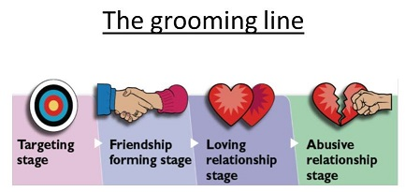
Child Sexual Exploitation (CSE)
Offenders and their behaviour:
What is ‘grooming’?
A process by which an offender/perpetrator prepares a child and/or the environment for subsequent abuse.
This will include gaining access to the child’s compliance and maintaining the child’s secrecy to avoid disclosure.
There are six stages in the process – targeting the victim, initially watching and then selecting; gaining the victim’s trust; fulfilling a need; isolating the child from peers and family creating vulnerability and dependence; sexualising the relationship; maintaining control.
Grooming can take place face-to-face, on the phone or on-line via social networking.
It can take place over varying lengths of time from days to months.
Offenders are likely to be grooming more than one young person at a time, potentially at different stages.
The NSPCC provide comprehensive information on grooming

Slide 5
Types of CSE
Peer on peer exploitation
Relationship model
On-line CSE
Youth produced sexual imagery identified in schools
Gangs and groups
County lines
Organised/networked sexual exploitation or trafficking
Familial
Opportunistic
Notes:
The details of each type of CSE are on pages 9 – 12 of the London CSE Operating Protocol (June 2017)
http://www.chscb.org.uk/wp-content/uploads/2017/06/LONDON-CSE-PROTOCOL.pdf

Slide 6
Child Sexual Exploitation (CSE)
Impact on individuals and families of CSE:
Subtle but destructive crime that can impact on every part of a victims health, well-being and development.
In particular, victims are at risk of sexual assault, rape, other violence, sexually transmitted infections, unwanted pregnancy, lack of educational progress, mental health issues.
Behavioural changes put families under stress – can lead to limited capacity to respond.
Children/young people are encouraged to distance themselves from their families.
Siblings put at risk of sexual exploitation.
Offenders may be threatening/aggressive towards family members.
Parents can feel frustrated and helpless when law enforcement and/or social care cannot stop the exploitation.
Complete relationship breakdown.
Child/young person becoming looked after.
At risk of further exploitation and harm.

Slide 7
Child Sexual Exploitation (CSE)
Indicators that a child or young person is being sexually exploited or is at risk of being.
Physical symptoms including change in appearance, sexually transmitted infections (STIs), bruising, pregnancy, change in dress code.
Mental health symptoms including, low self-esteem, self-harming, eating disorders, self-neglect, bed-wetting, fear of the dark.
Changes in behaviour/character, including aggression, secretive, lying, no behavioural barriers, being withdrawn, moody, risk taking, promiscuity/sexualised behaviour/talk, loss of interest in usual activities/interests.
Change in school/college attendance and fall in educational attainment.
Episodes of being missing from home, staying out late, arriving late and visiting high-risk areas or addresses of concern.
Presence of unexplained ‘gifts’ including luxury items e.g. money, new clothes, mobile phones.
Misuse of drugs and alcohol or increase in this.
Trust issues with adults.
New/second mobile phone, Increase in receipt of text messages , phone calls and time spent on the Internet/Social Media.
Change in friendship group - older friend(s)
Hearsay/rumours from other young people.
Sudden interest in a particular religion/faith.
Notes:
Barnardo’s provide a leaflet for professionals working with young people call ‘Spot the Signs’
http://www.barnardos.org.uk/spot_the_signs_professionals.pdf

Slide 8
Child Sexual Exploitation (CSE)
Prevention and protection of children and young people at risk:
Ensure that the workforce and parents understand why is usual adolescent behaviour and what is a-typical.
Identify those that are vulnerable and develop strategies to reduce risk, including supporting attachment.
Education – promotion of positive sexual relationships with young people – what is ‘healthy’ and what is ‘unhealthy’. Develop ‘listening’ relationships with children and young people – believe what you are being told.
If you receive a disclosure, carefully note down exactly what the child/young person has said and refer on.
Foster positive information sharing and seek advice/support early.
Be aware of services that support children that go missing/runaway.

Slide 9
Child Sexual Exploitation (CSE)
Myth Vs. Reality
Myth - There are very few ‘models’ of CSE.
Myth – It only happens in certain ethnic/cultural communities.
Myth – It only happens to children in care.
Myth – It only happens to girls and young women.
Myth – It is only perpetrated by men.
Myth – Perpetrators are always much older than their victims.
Myth – It only happens in large cities and towns.
Myth – Resilience is the same as coping.

Slide 10
Child Sexual Exploitation (CSE)
The Redbridge Context
The Multi Agency Sexual Exploitation (MASE) meeting takes place monthly and is led in line with the Pan-London Child Sexual Exploitation Operating Protocol (June 2017).
Redbridge LSCB CSE Prevention and Intervention Strategy, 2nd Edition, 2018
Redbridge LSCB Missing from Care or Home Policy, 2nd Edition, 2017 and Missing Panel.
Operation ‘Make Safe’ – police and community safety led-initiative with local businesses.
Case work intervention/therapeutic work from Safer London Foundation, Barnardo's and Refuge.
CSE Lead for LB Redbridge – Cathy Worboyes, Head of CPAS and Early Intervention.
CSE Co-ordinator for LB Redbridge – Anna Watson, CPAS

Slide 11
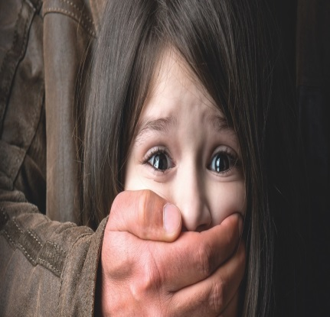
Child Sexual Exploitation (CSE)
Key points for learning:
cascade key learning points with colleagues to raise awareness;
raise awareness with parents/carers;
be observant;
recognise the signs;
listen to what young people tell you;
remember that they are a victim;
clearly record and gather evidence; and
refer to the Child Protection and Assessment Service (CPAS) using a Multi-Agency Referral Form (MARF).

Slide 12
Child Sexual Exploitation (CSE)
Useful Resources:
Working Together to Safeguard Children, 2015
Keeping Children Safe in Education, 2016
London Child Protection Procedures, 5th Edition, 2017
‘Worried about a child? LSCB Multi-Agency Threshold Document
London CSE Operating Protocol, 3rd Edition, June 2017
LSCB Training Programme – Introduction to CSE (1/2 day) and CSE for Practitioners (full day)
LSCB eSafety and Peer-on-Peer Abuse Resource Directory
Notes:
National CSE Awareness Day is held each year on 18 March
https://www.nwgnetwork.org/national-child-sexual-awareness-day-2018/

