Slide 1
Somebody else’s child
Presentation on
Private Fostering
for use by LSCB partner agencies

Slide 2
Learning Outcomes
By the end of the presentation, viewers will be able to:
Recognise a private fostering arrangement;
Understand the Local Authority’s duties towards privately fostered children; and
Know how to notify about a private fostering arrangement.

Slide 3
What is Private Fostering?
For a child who is under 16 (under 18 if disabled)
A private arrangement between a parent and a carer
What is
Private Fostering?
For 28 days or more
To live away from home and be cared for by someone who isn’t a parent, a person with PR or a ‘close relative’
(legally defined as:
Step-parent, grandparent,
sibling, aunt or uncle)

Slide 4
Somebody Else’s Child
Short film (8.5 minutes) on Private Fostering produced by BAAF.
http://www.privatefostering.org.uk/profs/video

Slide 5
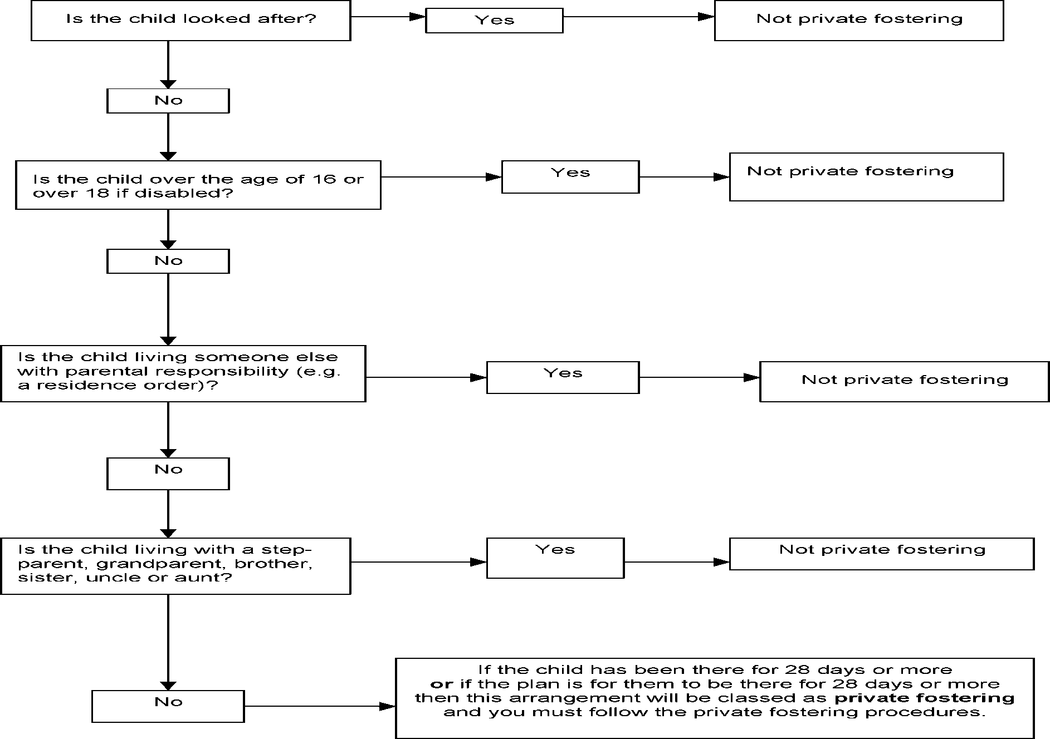
Decision Flowchart
Flowchart for use when a child is living with someone other than a parent

Slide 6
Vulnerable Children
Private fostered children are not the same as ‘fostered’ children
Privately fostered children are potentially vulnerable
By law parents and carers must notify the Local Authority of these arrangements – most don’t
Many privately fostered children don’t receive the services and protection they are entitled to because they are not known to their local authority
Victoria Climbié was a privately fostered child.

Slide 7
Why might a child or young person become privately fostered?
Parenting capacity
Parent in prison
Family crisis or row with parents
Parents gone overseas or
Working elsewhere
To complete education
Attending a language school
During boarding school holidays
Sent to UK for a ‘better life’
Parent from overseas studying in UK
From overseas with a view to adoption
Trafficked into the UK

Slide 8
Roles & Responsibilities
Those working with children and families play a key role in identifying privately fostered children
It is the responsibility of everyone that works with children and families to make sure the Local Authority has been notified about any private fostering arrangement they are aware of.

Slide 9
Under the Children Act 2004 and the Children (Private Arrangements for Fostering) Regulations 2005 Local Authorities are required to Local authorities have a duty to:
Raise awareness of the requirement to notify them of private fostering arrangements
Satisfy themselves that the welfare of the privately fostered child is being satisfactorily safeguarded and promoted.
Advise and support children who are privately fostered, their parents and carers

Slide 10
We all have a responsibility to safeguard
If you think you may have identified a private fostering arrangement don’t ignore it. Speak to the parent or carer and make sure they are aware of their duty to notify
Follow up and let Children’s Services know if you have reason to believe the Local Authority has not been notified
If you feel it is not appropriate to speak to the parent or carer don’t ignore it. Pass the details on to Children’s Services who will follow up

Slide 11
What will Redbridge Children’s Services do?
Child & Family Assessment will be conducted to identify the child’s needs, risks or safeguarding issues.
A Private Fostering Assessment will be undertaken to assess whether the carer, accommodation and arrangements are safe and suitable for the child, or young person.
Action will be taken to protect the child where the arrangements are assessed not safe or suitable.
Make sure the young person is happy with the arrangement.
Offer support and advice to the child, carer and parents.
Visit the child regularly (6 weekly for the first year and 12 weekly until the child is 16) to make sure everything is going smoothly and the arrangement remains safe and suitable for the child.

Slide 12
Who should be notified?
Child Protection and Assessment Team (CPAT) Lynton House, 255-259 High Road Ilford, IG1 1NN Tel: 020 8708 3885 or e-mail CPAT.Referrals@redbridge.gov.uk
For general advice on Private Fostering, you can also contact the Private Fostering Worker or Team Manager on 0208 708 7874 or view the information on the LSCB website.

